Slide 1
Admissions
Karen Rankin
Graduate College
Admission Counselor
Phone: 757- 727- 5454
Email: hugrad@hamptonu.edu

Slide 2
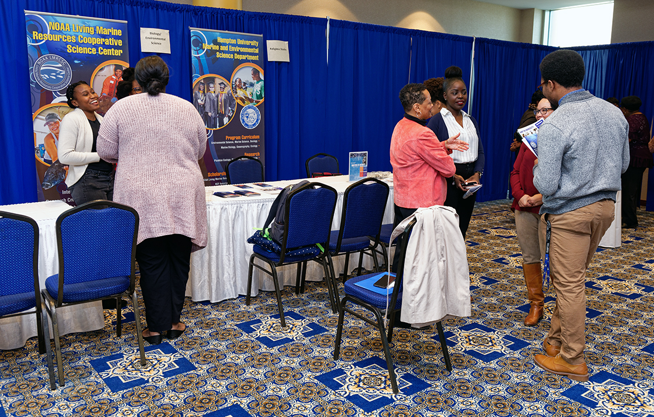
Our Website
On the Graduate College website, you will find a variety of useful items relevant to graduate students.
Prospective students can find information related to admissions.
Newly admitted students can find items needed to get you started.
Current students can find documents, forms, and graduation requirements.
Outside of platforms designated for coursework, visiting our website is highly encouraged.
http://gradcoll.hamptonu.edu/

Slide 3

Applying
There are 7 easy steps to complete your graduate admission application:
Main Campus Programs:
Degree Seeking Students
Completed online application
$50 non-refundable fee
An official transcript from each college/university attended
Official test scores of the:
MCAT or DAT (Medical Science applicants)
GMAT – MBA 5YR – Program is offered to continuing Hampton University undergraduate Business Students Only
*** SUBMISSION OF THE GRE SCORE IS WAIVED INDEFINITELY FOR ALL MAIN CAMPUS APPLICANTS
In addition to the above test scores:
PRAXIS (Education applicants)
TOEFL or IELTS (Applicants whose native language is not English)
Two letters of recommendation (recommender signature is required on letterhead)
Three letters of recommendations required for Atmospheric and Planetary Science
Personal Statement
Resume (Counseling Applicants)
ATTENTION DOCTOR OF PHYSICAL THERAPY APPLICANTS: In addition to your PTCAS application the Graduate College requires the following; 1) $50 application fee, 2) Online Graduate College application, and 3) Signature page. The remaining applicable documents above are already included in the PTCAS application and do not need to be resent. ATTENTION COMMUNICATIVE SCIENCES AND DISORDERS’ APPLICANTS: In addition to your CDSCAS application the Graduate College requires the following; 1) $50 application fee, 2) Online Graduate College application, and 3) Signature page. The remaining applicable documents above are already included in the CDSCAS application and do not need to be resent.
Non-Degree/Special students
Completed online application
$50 non-refundable fee
An official transcript from each college/university attended
Submit official transcript(s) from each college/university attended
*Please note, according to the Office of Financial Aid and Scholarships, special (non-degree) students are not eligible to receive federal funding. Please consult immediately with the Financial Aid Office to discuss funding options, if so desired.
Complete the online application.
Pay your application fee.
Submit official test scores for GMAT, MCAT or DAT.
Submit PRAXIS Scores (Education Applicants
Submission of the GRE Score is waived indefinitely for all main campus programs.
Submit official transcripts.
Submit your supplemental documents.

Slide 4
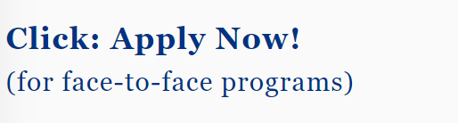
Completing the Application
Before completing the application, please be sure to consider deadlines.
The link to access the application can be found on our prospective students page; Or by clicking the below link.
http://gradcoll.hamptonu.edu/page/Admission-Requirements
Deadlines for Admission
November 15, 2023 Entering Spring Semester
January 15, 2024 Physical Therapy Program Fall Semester
May 1, 2024 Communicative Sciences and Disorders Fall Semester
April 1, 2024
Entering Summer Session
JUNE 1, 2024 Entering Fall Semester
*Note: The Physical Therapy, Medical Science, and Communicative Sciences & Disorders programs only review applications for Fall Semester entry. Please note the deadlines above.

Slide 5
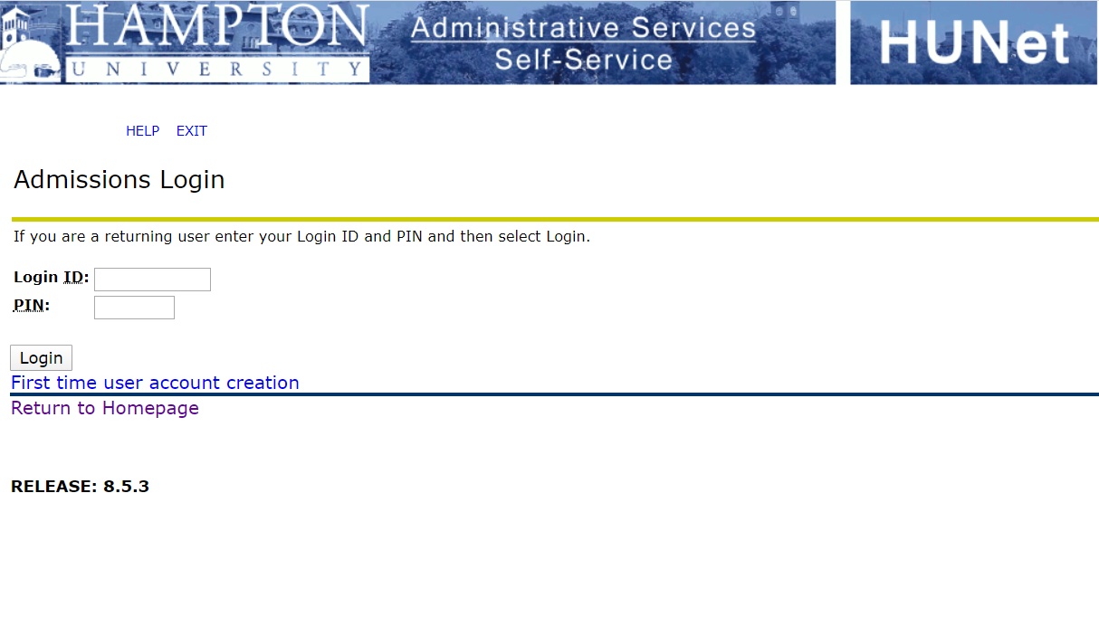
The Application
The online application will require the creation of login credentials. Please remember these credentials because they will allow you to revisit your application. Once your account is created you can begin the application process.
Main Campus Application
Graduate College Admission

Slide 6
Completing the International Application
Before completing the application, please be sure to consider deadlines.
The link to access the printable application can be found on our prospective students page; Or by clicking the below link.
International Students Admission Requirements
Deadlines for Admission
April 1, 2024
Entering Fall Semester
September 1, 2024
Entering Spring 2025 Semester
January 15, 2024
Physical Therapy Program*
February 1, 2024
Entering Summer Session
*The Physical Therapy, Communicative Sciences & Disorders and Medical Science programs only review applications for Fall Semester entry. Please note the deadlines above.
http://gradcoll.hamptonu.edu/page/International-Students-Admission-Requirements

Slide 7
The Application fee
The application fee is $50.00 (non-refundable).
It can be paid by:
Money order or certified bank check.
American Express, Discover Card, Master Card and Visa are accepted.
Personal checks will not be accepted.

Slide 8
Official Documents
Supplemental Documents
An official transcript from each college/university attended
Official test scores of the:
MCAT or DAT (Medical Science applicants)
GRE IS WAIVED INDEFINITELY FOR ALL MAIN CAMPUS APPLICANTS
GMAT – MBA 5YR Program – program offered to continuing undergraduate Business students only
Resume (Counseling applicants only)
In addition to the above test scores:
PRAXIS (Education applicants)
TOEFL or IELTS (Applicants whose native language is not English)
Two letters of recommendation (Must be on official letterhead. Recommenders signature is required)
Three letters of recommendations required for Atmospheric and Planetary Science applicants
Personal Statement
Copy of Passport/Visa (International Students only!)

Slide 9
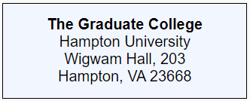
Document Submission
Your supporting documents can be mailed to:
OR, supporting documents can be emailed to:
hugrad@hamptonu.edu
The Graduate College will forward your application packet to the appropriate academic department to review once your file is complete. A decision letter will be sent via email once the review process has been completed.
Please Note: Prospective graduate applicants are encouraged to complete an online application. An application is NOT considered complete without an application packet. A completed application packet includes all supplementary materials (application fee, signature page, personal statement, transcript(s), required test scores and recommendation letters) these materials must be mailed or emailed directly to the Graduate College.

Slide 10
Thank You!

