Slide 1
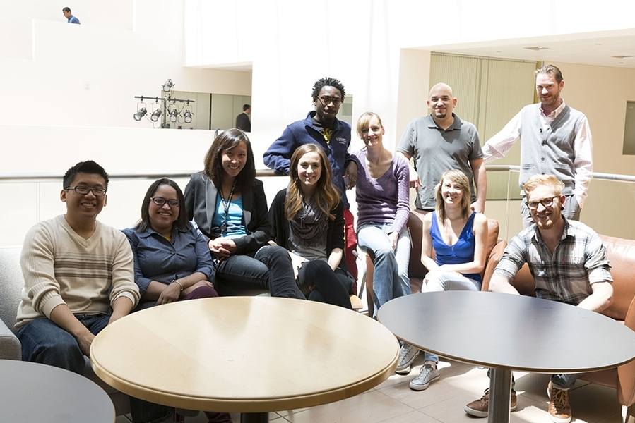
Advisement Tips for Faculty

Slide 2
Key Tips
Familiarize yourself with the academic policies in the academic catalog and departmental handbook, if applicable.
Seek mentorship from experienced faculty advisors or mentors for guidance.
Explore professional development. The National Academic Advisors Association (NACADA) is the association that I am an active member of, and they do have a significant amount of resources and professional development for faculty advisors https://nacada.ksu.edu/.

Slide 3

Communicate early and often
Establish clear expectations and maintain consistent communication.
Use open-ended questions and active listening. Encourage students to share their goals and concerns.
Be empathetic and supportive. Recognize that both advisor and advisee can benefit from strong relationships.
Share your own experiences. Be open and honest about your life and career path.

Slide 4

Use the 3-I Process: -Inquire about student needs (their interest and goals) -Inform them about relevant resources, and -Integrate their goals into a plan.

Slide 5
Offer Constructive Feeback
Help students reflect on their strengths and weaknesses.
Be aware of Campus and Community Resources
Know when and where to refer students for specific needs.
Make Effective Referrals
Guide students to appropriate support services and resources.

Slide 6
Leverage Technology and Data
Utilize advising tools:
Explore DegreeWorks and other technologies such as Navigate360 to streamline the advising process.
Analyze student data: Identify trends and patterns to inform advising strategies.
Consider virtual advising: Explore the use of platforms like Zoom for remote advising appointments.

Slide 7

No Surprises
No student should ever be surprised about their standing in a course or a program. Consistent and accountable communication and empathetic advisement ensure that we maintain the integrity of our programs while also supporting academic excellence and student success. Here is a working list of resources: https://docs.google.com/document/d/1awATR70qDi87jnXdI8NCEuYQBbTpDbF9-l6VCsVdKFo/edit?usp=sharing.

Slide 8
Thank you
Kristie Cansler, M.Ed.
Graduate Counselor
757.727.5736
Kristie.cansler@hamptonu.edu
Graduate College, 309-A Wigwam

