Slide 1
Cisco Networking Academy Program & Marketing Slides

Slide 2
Cisco Networking Academy Marketing have provided slides to promote the following:
NetAcad impact infographics
Marketing Round Table
Marketing Tool Kit for Academies
Editorial themes each quarter in FY21
Cybersecurity Month
Thought Leadership Podcast series for FY21
Marketing Programs Beyond the Classroom (Women Rock-IT / Learn-A-Thon)
Talent Bridge Program – Connecting students to jobs
IPD week
Success Stories & how to submit
Learning Pathways
Partner, instructor and student newsletters
Digital Badges & certification
YouTube videos

Slide 3
















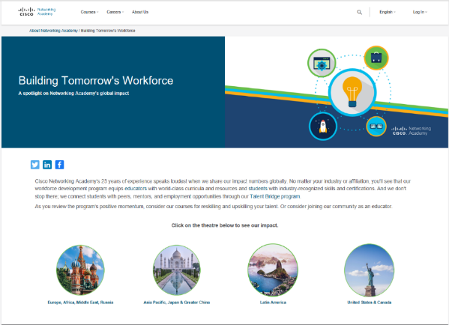
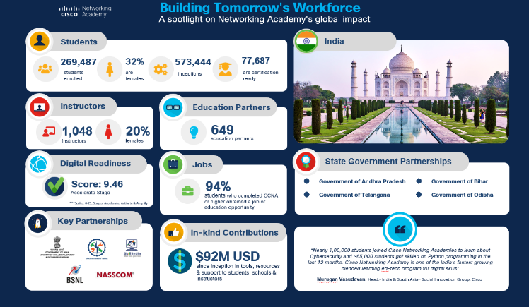
Celebrating our Impact Around the World
Microsite
NetAcad Impact Infographics
Dedicated landing page with social shares
70 selected regions & countries
Visit
https://www.netacad.com/about-networking-academy/global-impact

Slide 4



CSR Impact Report
2.3 million
employee engagement, allowing us to meet our FY20 goal
4th Annual
81%
Cisco Global Problem Solver Challenge Grand Prize of $100k awarded to Savanna Circuit Tech of energy came from renewable sources (FY22 goal of 85 percent)
students participated in Cisco Networking Academy in FY20, bringing the total since inception in 1997 to 12.6 million students
pledged to organizations focused on social justice
$5 million
No. 1
Gartner Supply Chain Top 25 for 2020 report
$458M
527 million
in cash and in-kind contributions to community programs by Cisco and the Cisco Foundation
People positively impacted through our social impact grants and signature programs
52%
of our 1B by 2025 goal
$53M
in cash and personal protective equipment
during Covid-19
83%
No.1
415W
55%
World’s Best Workplace 2019 and 2020, according to Great Place to Work®
of energy came from renewable sources
(FY22 goal of 85 percent)
power requirements of the Cisco 8201 router, 26x less than a predecessor, the NCS 6008
reduction in Scope 1 and 2 greenhouse gas emissions (FY22 goal of 60 percent)
For Full Details Visit: https://www.cisco.com/c/m/en_us/about/csr/esg-hub.html

Slide 5





What we made possible in FY20
of our
1B by 2025 goal
527M
people positively impacted
No.1
World’s Best Workplace 2019 and 2020, according to Great Place to Work
55%
52%
2.3M
students participated in
Cisco Networking
Academy in FY20, bringing
the total since
inception in 1997 to 12.6 million students
reduction in Scope 1 and 2 greenhouse gas emissions (FY22 goal of 60 percent)
83%
of energy came from renewable sources
(FY22 goal of 85
percent)
81%
employee engagement, allowing us to meet our FY20 goal
$5M
pledged to organizations
focused on social justice
No.1
Gartner Supply Chain Top 25 for 2020
$458M in cash and in-kind contributions to community programs by Cisco and the Cisco Foundation
4th annual Cisco Global Problem
Solver Challenge Grand Prize of $100k awarded to Savanna Circuit Tech
$53M in cash and personal protective equipment
during Covid-19
415W
power requirements of the Cisco 8201 router, 26x less than a predecessor, the NCS 6008

Slide 6



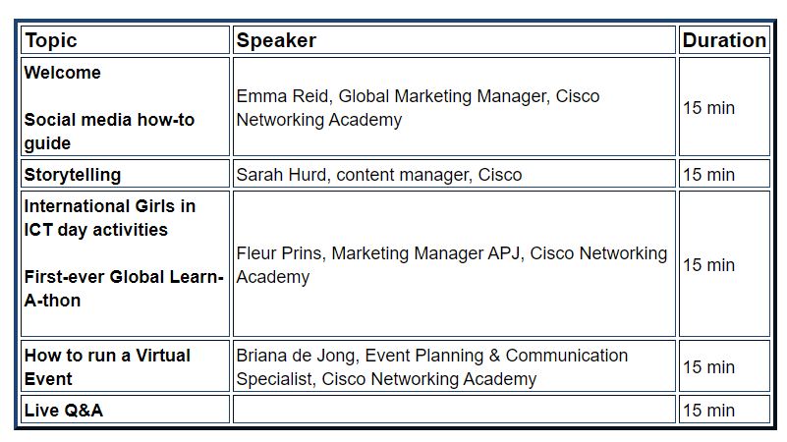
MARKETING ROUND TABLE MARK YOUR CALENDERS EMEAR Friday 11 Feb 9:30am London, 10:30am Amsterdam, 11:30am South Africa, 1:30pm Dubai
APJ Friday 11 Feb 9:30am India, 12:00noon Singapore, 3:00pm Sydney
USC Friday 11 Feb 1:00pm Pacific Time, 3:00pm Central Time, 4:00pm Eastern time
LATAM Thursday 25 Feb 9:00am Mexico Time, 12:00noon São Paulo and Buenos Aires
Agenda, 11 Feb 2021
WHAT IS THE MARKETING ROUND TABLE? Instructors and marketing professionals attending the Networking Academy Marketing Round Table will discover best practices.
A free, one-hour session for marketing professionals to successfully attract news students and engage existing ones.
From marketing keynotes to sharing best practise examples, you’ll walk away with fresh ideas for your marketing campaigns.
Notes:
Marketing Round Tables
Inaugural Launch Events and links to invites / landing pages
First event on October 22, 2020:
APJ: Discover best practices at the Cisco Networking Academy Marketing Round Table. A free, one-hour session for marketing professionals to successfully attract news students and engage existing ones. Launching on October 22, 2020, across three time zones.
Terms and Conditions | Privacy Statement | Cookie Policy | Data Protection | Trademarks | NetAcad.com
From marketing keynotes to sharing best practise examples, you’ll walk away with fresh ideas for your marketing campaigns
EMEAR: http://csrinfo.cisconetspace.com/Q1MarketingRoundTableEMEAR_RegistrationPage.html
USA/CA: http://csrinfo.cisconetspace.com/FY21Q1MarketingRoundTableUSC_RegistrationPage.html
LATAM: Coming soon

Slide 7


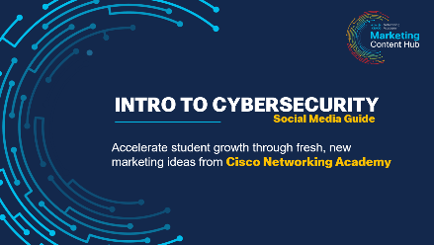
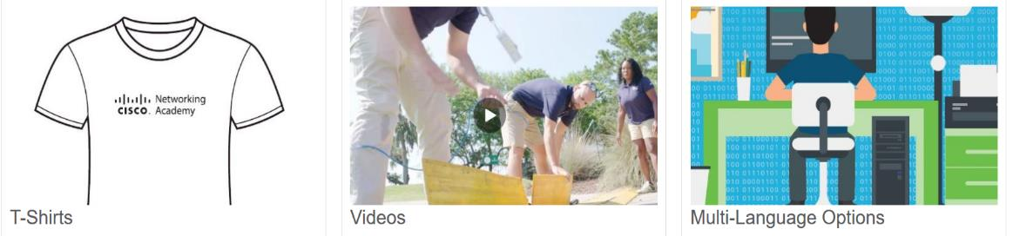
Networking Academy Marketing Tool Kit
Each quarter new content will be shared on our Marketing Toolkit to support our quarterly editorial themes. Find it under the top “What’s new” section.
Easy to navigate
NEW Social Media ‘How to Guides’
Login with your Academy ID
Search for items you need!
https://www.netacad.com/portal/content/global-marketing-toolkit

Slide 8





Editorial Quarterly Themes
01
02
03
04
AUGUST / SEPTEMBER / OCTOBER
NOVEMBER / DECEMBER / JANUARY
FEBURARY / MARCH / APRIL
MAY / JUNE / JULY
BECOME MORE CYBERSMART
ENTRY INTO NETWORKING
ALL SIDES OF PROGRAMMING
THE FUTURE OF WORK
How educators and students can test their knowledge on what it takes to be safe and more secure online.
How students can feel smarter by taking their first tech course. Start with IT or Networking Essentials. Then build a foundation for CCNA and get hooked!
How students can start; how they can groom new skills; how they can find lucrative jobs AND love the freedom and creativity of this type of career!
How students can find their place in the future of work through the power of networking and automation-focused careers.
Supports Networking Essentials launch
Promotes DevNet Assoc and jobs of the future
Supports Cybersecurity Awareness Month
Capitalizes on programming popularity
IN-DEPTH THEMES TO BETTER ENGAGE STUDENT AUDIENCE
Notes:
Building Communities up and driving business forward to ensure an inclusive future for all
Q1 Cybersecurity
Cybersecurity is NetAcad’s most fascinating topic in 2021
Cybersecurity a future-proof career.
Q2: Networking
Launching 100% self paced Networking Essentials. How students can find their place in the future of work through the power of data-driven and automation-focused careers.
Q3: Coding
How can students start?
How students can groom new skills.
How students can find lucrative jobs and love the freedom and creativity of this type of career.

Slide 9
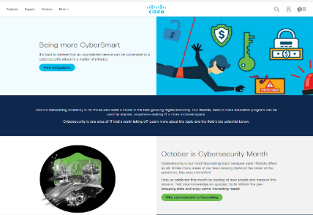
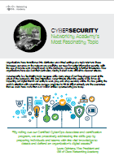
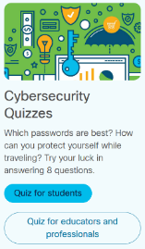


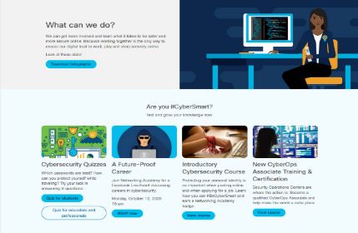








CYBERSECURITY MONTH
URL: https://www.cisco.com/c/m/en_sg/partners/future-yourself.html
Thought-leadership 1-pager
Student & educator quizzes
Two CSR blogs
Cybersecurity Champion winners
Dedicated landing page
Infographic
Facebook Live Event
Enroll in self-paced courses
Additional resources
Roll-out Teasers in Sept newsletters; featured in October newsletters; weekly News & Events articles; and steady social media push

Slide 10



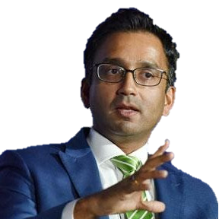








Learning Never Stops Podcast
The Thought Leadership Series: Connect new ideas, practices and transformative technologies to help on your lifelong learning journey
https://www.netacad.com/region/north-america/podcast
Our Host
Philippe Landry
The Future of Work & the Impact on equality with Laura Quintana, VP & GM of Cisco Networking Academy
The unprecedented changes brought about by COVID-19 has affected many individuals, communities and disproportionately women, for whom the ILO reports higher unemployment rates. This is the case in the United States, Germany and Australia. In the United States between December and April 2020, women’s unemployment rose by 11%. Hear what Cisco is doing to tackle the gender gap through Cisco Networking Academy
The Modern Network
with Pradeep Kathail, Chief Network Architect, Intent Based Networking Group
Hear from one of Cisco’s masterminds on how the network and networked applications are keeping businesses more agile, secure and competitive.
The Secret is APIs
with Susie Wee, SVP & GM of DevNet & CX
Founder of Cisco DevNet shares how the industrial shift combining engineering and software brought opportunity. And how new certifications are now bringing program credibility.
Future of Work
with Naveen Menon, Cisco President ASEAN
Work is changing faster thanks to augmented technology and automation. What does it mean for the workforce? Cisco senior leader sheds light on this and much more.
Cybersecurity
with Josh McCloud,
Cisco National Cybersecurity Officer
Learn how great minds are thinking about the challenges of cybersecurity and what all of us can do to minimize its risks.
Notes:
The analysis highlights that there is an acute skills shortage, particularly in technical skills and IT, across all six major ASEAN economies. There is a need for formal training and education to produce a larger number of specialist workers. According to our estimates, around 41% of workers who are likely to be displaced in the next decade are acutely unprepared for IT-related roles.
In addition, many workers will need to transition into jobs requiring softer, customer-oriented or interactive skillsets. These will require a range of training approaches, including greater commitment to on-the-job training, more flexible online courses and, in some cases, work experience schemes to compliment (or even substitute for) formal schooling and tertiary education.
There is no one quick fix or solution to this. All stakeholders need to work together – from governments to businesses and institutions. The governments need to introduce changes to education policies that make it easier for citizens to reskill and retrain as technology innovations gather pace and the labour requirements change. Businesses need to play their part in pre-empting their future requirements and reskilling their staff to minimize displacement. Educational institutions have a key role to play in helping governments and business achieve those goals.
The bounty of technological innovation which defines our current era can be leveraged to unleash human potential. We have the means to reskill and upskill individuals in unprecedented numbers through Networking Academy

Slide 11
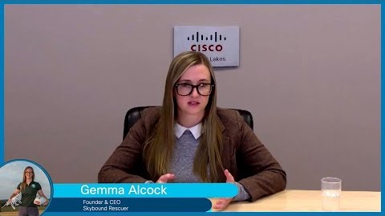





Women Rock-IT
Join us for the FREE "Women Rock-IT" live TV broadcasts and hear from some "Rock'in" women who have challenged stereotypes and turned their passion for technology into rewarding and successful careers.
Scan Me
Find a session near you or host your own session on-campus
United States & Canada
Asia Pacific and Japan
Europe, Middle East, Africa & Russia
Latin America

Slide 12







Women Rock-IT Impact Since 2014
Viewership
Countries
Course Registration
Broadcasts
Speakers
Blogs
1.778.579
200
553,572
60
110
58
Updated: October 2020

Slide 13









Marketing Assets Live Broadcasts, Invites, Blogs, Digital Magazine, On-Demands, Posters,
https://www.cisco.com/c/m/en_sg/partners/women-rock-it.html
Web Banners
Speaker Blogs
Facebook Live Streams
Social Media Banners
Digital Magazine
Editable Poster
Notes:
Social Media: All social media advertisements are located on our Women Rock-IT website. We encourage all Academies to have their social media team share the live broadcast on their own social media platforms – Facebook, Twitter and YouTube.
The live broadcast can be found on as follows:
Cisco Networking Academy Facebook Page
Cisco TV YouTube Account
Twitter – Usually we stream live on our speakers Twitter account.

Slide 14

Women Rock-IT Guide on Organising On-Campus Events
https://www.cisco.com/c/m/en_sg/partners/women-rock-it/ebook/index.html

Slide 15
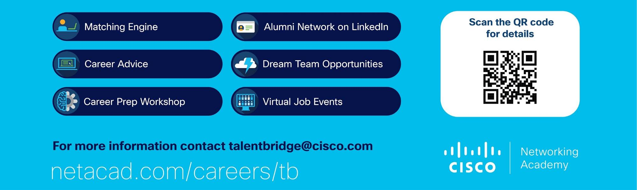
Talent Bridge Program
Talent Bridge is our employment program for Cisco Networking Academy
Talent Bridge connects Cisco and partner employers with world-class Networking Academy talent for the digital economy workforce of the future. The program offers valuable free resources for both employers and students—helping employers find technology-savvy talent and supporting students as they emerge from academic learning to begin their careers.

Slide 16
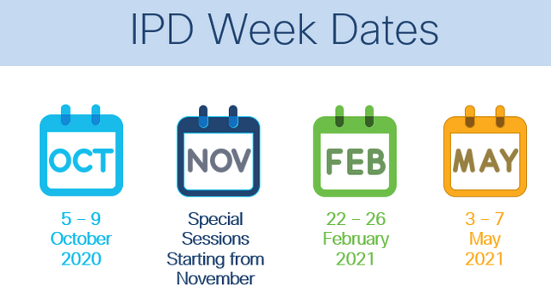


IPD Program
#LearningNeverStops
Cisco Networking Academy invests in your professional development the way no other industry program does
Attend free sessions to learn the latest about the program and to gain knowledge and skills beyond course content!
https://www.netacad.com/portal/resources/professional-development/ipd-week

Slide 17
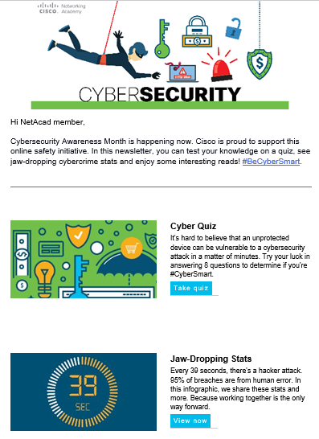
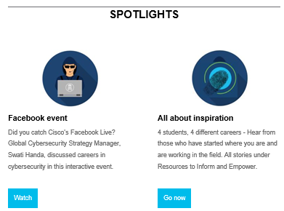
Stay Connected
With us through our partner, instructors and student monthly and quarterly newsletters.
Our newsletters are translated into English, French, Russian and Spanish.
To receive our newsletters, please opt in to hear from us.

Slide 18


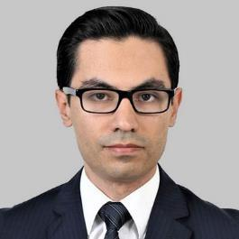
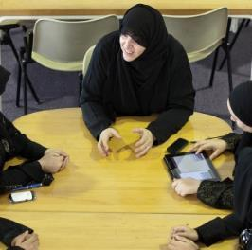

Success Stories
Tips for Online Teaching Success from a Seasoned Cisco Networking Academy Online Instructor
Relationships Jump Start an IT Career
How One Cisco Networking Academy Cybersecurity Instructor Is Changing Lives
Women Lead by Example
Success Stories to share with your class Visit: https://www.netacad.com/careers/success-stories

Slide 19
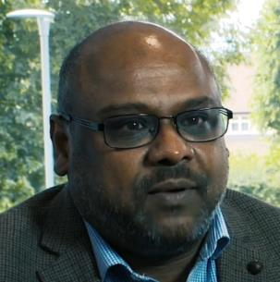


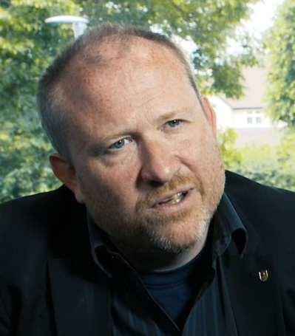
Everyone has a story
Let us tell yours
Submit stories in our easy-to-use Content Development Hub on the CEC CSR page
Notes:
Cisco Networking Academy students, alumni, instructors, and academies have achieved excellence in many fields of endeavor, often overcoming hardships and adversity to create their own pathways to success. Sharing success stories allow us to celebrate their achievements while giving our viewers an inside look at the people who are making significant achievements in their academic life, professional field, or in the community
Submit stories in our easy-to-use Content Development Hub on the CEC CSR page
.

Slide 20
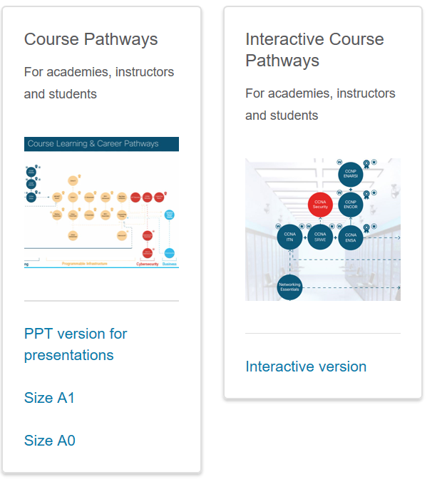
Course Pathways Poster and PPT
Available now is the NetAcad course pathways poster and PPT. Use this to reflect the latest digital badges and inspire students to take NetAcad courses.
AVAILABLE NOW on the NetAcad Marketing Tool Kit
https://www.netacad.com/portal/resources/marketing-toolkit/posters

Slide 21



New Course Highlights
Networking
CCNA (3 courses)
Infrastructure Automation
DevNet Associate
Cybersecurity
CyberOps Associate
Find out more at www.netacad.com

Slide 22

Practice with Packet Tracer
anytime, anywhere
Cisco Packet Tracer is a powerful simulation and visualization learning environment for building simple and complex networks.
Great for lectures, labs, games, homework, assessments, and competitions
Students can quickly try, experiment, learn, repeat
Practice teamwork, critical thinking and creative problem solving
Integrated with online assessment engine
Learn more at: www.netacad.com/courses/packet-tracer
Notes:
Marketing Round Tables
Inaugural Launch Events and links to invites / landing pages
First event on October 22, 2020:
APJ: Discover best practices at the Cisco Networking Academy Marketing Round Table. A free, one-hour session for marketing professionals to successfully attract news students and engage existing ones. Launching on October 22, 2020, across three time zones.
Terms and Conditions | Privacy Statement | Cookie Policy | Data Protection | Trademarks | NetAcad.com
From marketing keynotes to sharing best practise examples, you’ll walk away with fresh ideas for your marketing campaigns
EMEAR: http://csrinfo.cisconetspace.com/Q1MarketingRoundTableEMEAR_RegistrationPage.html
USA/CA: http://csrinfo.cisconetspace.com/FY21Q1MarketingRoundTableUSC_RegistrationPage.html
LATAM: Coming soon

Slide 23

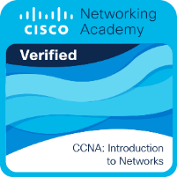
Digital Badges
Certifications
Issued by Cisco and embedded with Metadata, Networking Academy digital badges provide a verification of skills in a single click. Students can proudly display on any online platform to:
Enhance their professional brand on social media, email signature, resume, website, portfolio and more
Enable employers to quickly validate their certifications and achievements
Completing one or more certifications can give students a real edge over other candidates applying for the same job. Having a certification also allows students to ramp up quickly into a new job.
To help students get lined up for the best outcome, this Certification Quick Reference Guide will help share what’s possible.
View video
Quick Reference Guide

Slide 24
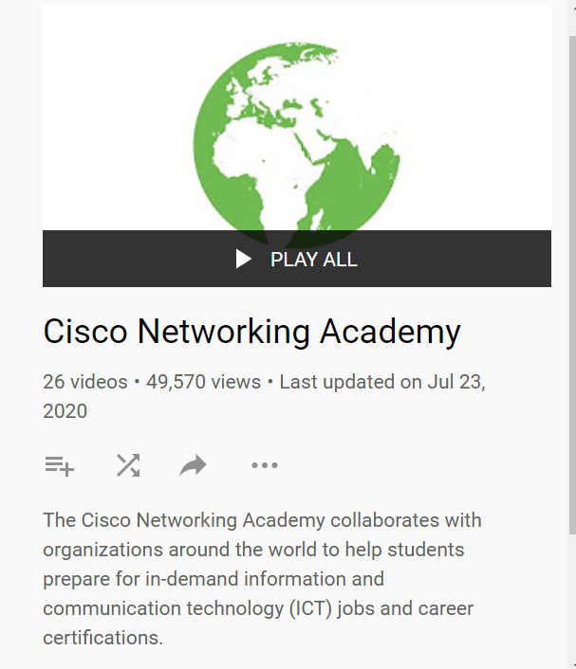

NetAcad YouTube Channel
Cisco YouTube Channel
https://www.youtube.com/user/Cisco/welcome
https://www.youtube.com/playlist?list=PLA48B49E7FB15439B&app=desktop

